Slide 1
Managing or adding an new interface language
SoMachine Basic V1.3
September 2014
G. Landru
Machine Solution

Slide 2
Introduction – Restriction
In this document, SoMB stands for “SoMachine Basic”
Starting V1.3, it is possible to enhance the supported languages of SoMB software
This allows to deploy SoMB with a local language
Unfortunately, some texts are not yet opened for translation
  Linked with catalog description
For all new SW version, there are some new texts to be translated

Slide 3
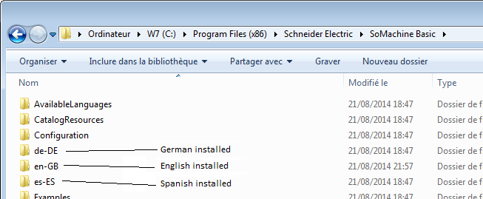
How it works 1/2
SoMachine Basic is developed in C# .NET
  Used the standard .NET mechanism for language management
  All supported language files are placed in a dedicated folder whose name is the language name
  Each language file is compiled for a specific language
    Not possible to replace a language by another by changing a language file

Slide 4
How it works 2/2
All strings in SoMB have a default value starting with “t-”
  These “t-” strings are strings put by developers, not validated by SoMB marketing
  If a string which appears starting with “t-” means it has not been translated or translation file is missing
From the software compilation, all strings are extracted, translated and language files are generated to be integrated in the setup

Slide 5
Steps to add a new language
Starting with SoMachine Basic V1.3, it is possible to add a new language
  Gets the language strings to translate
    We should translate all the strings included in Excel file named “SoMB_strings.xlsx”
    You can find it in folder “<programs>\Schneider Electric\SoMachine Basic\AvailableLanguages”
  Generate or ask to generate the corresponding language files for a specific language code
    Send this excel file to product manager
    He will send you back the folder with generated dll files
  Copy the new files in their dedicated folder at same level as other languages
  Edit the file \AvailableLanguages\AvailableLanguages.xml (where SoMB is installed)
  Add the new language:
    Ensure code is the same than generated files and the new folder name
    Enter the Name of the new language (rule is ‘name in English’ – ‘name in specific language’)
    Point to a End User License Agreement file (use English)
    Restart SoMB, the new language should appear in the list

